Slide 1

Kevin Sacerdote
Mandarin High School
Jacksonville, FL

Slide 2

Origins of the Cold War
Relevant Overview

Slide 3

On The Origins of War:
and the
Preservation of Peace
Donald Kagan (437 – 441)

Slide 4
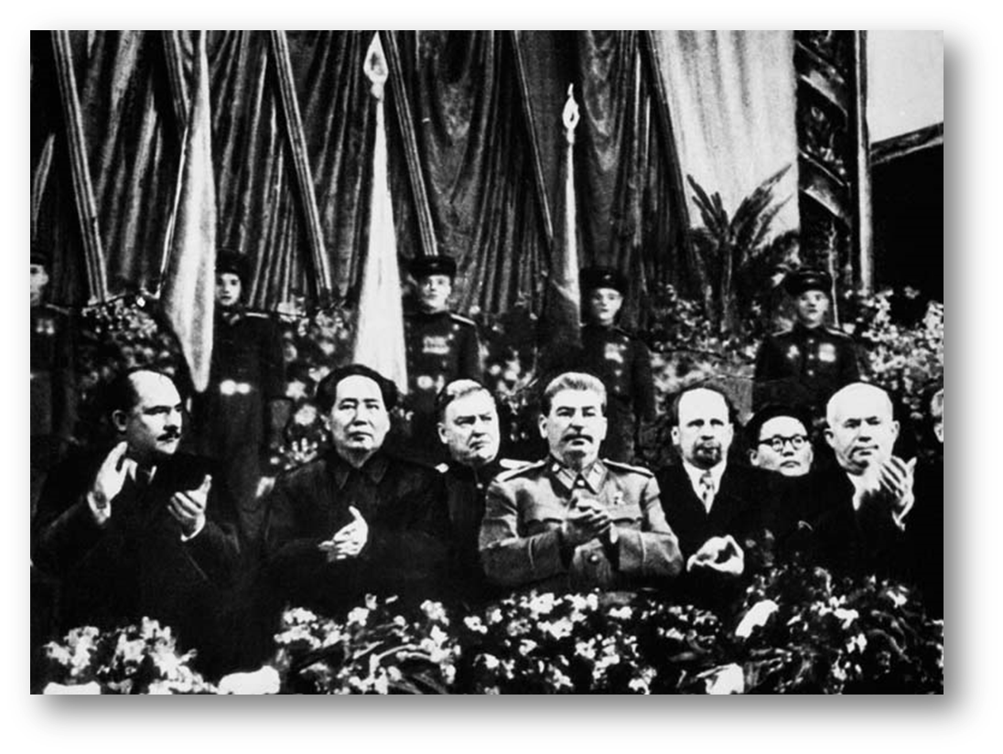
The Sino-Soviet Friendship and
Mutual Assistance Treaty
(Valentine’s Day 1950)

Slide 5
The Sino-Soviet…Treaty
(Encyclopedia of the Cold War, Volume II, Rudd van Dijk, ed., p. 788)
For Moscow
For Beijing
“It strengthened the Soviet position in the global struggle with the United States.”
“It provided political and diplomatic support as well as much needed economic and military aid to the newly founded People’s Republic of China (PRC).”

Slide 6
The Sino-Soviet Treaty of Friendship, Alliance, and Mutual Assistance
Signed by Stalin & Mao February 14, 1950
Soviets promised technical help and $300 million in loans
  Far less than the Chinese expected
  Mao stated that, getting money from Stalin was like taking “meat out of a tiger’s mouth” (Powaski, p. 83)
  The Soviets retained rights over the Manchurian rails and bases in Port Arthur and Darien

Slide 7
The Sino-Soviet Treaty of Friendship, Alliance, and Mutual Assistance
“The Sino-Soviet partnership was based on three elements:
  1. Party
  2. Military, and
  3. Economic Relations” (Luthi, p. 32)

Slide 8
Friendship With The CPSU
“Unlike the East European states, China voluntarily joined [the socialist camp] on the assumption that only the anti-capitalist and anti-imperialist Soviet Union would support the PRC in its struggle to regain prosperity and international standing”
(Luthi, 19)

Slide 9

What Went Wrong?
Crisis and Collapse: 1958-1969

Slide 10
Seven Agents for CCOT
(Source: AP World History Acorn)
1. The Ideas of Great Thinkers
  Should Influential Replace Great?
    Machiavelli v. Marx v. Locke v. Hitler
2. The Policies of Leaders
  Domestic & Foreign Policy Decisions
  Stalin & Mao’s Price for Progress
3. The Struggles for Power
  How to Gain and Retain
    The CCP in 1989, versus CPSU 1989-1991

Slide 11
Seven Agents for CCOT
(Source: AP World History Acorn)
4. Conflict Between the Classes
  Kaiser Wilhelm II & the Junkers fear of an Educated Proletariat becoming restless
  Germany Leads Second Industrial Revolution
  Deflect via the use of Ultra-Nationalism (Cost = World War I)

Slide 12
Seven Agents for CCOT
5. Impact of New Technology
  “Have’s” versus “Have-not’s” Gap Widens
  Fuels Ultra-Nationalism
    Paris Exhibition (Pre WW I) Germany’s New Canon is a “hit” with the crowds
6. Growth & Decline in Population
  Europe & the Russian Federation Today
7. Variations in Climate & Mother Nature
  Haiti 2010

Slide 13

Case Study One:
The Cause(s) of World War One

Slide 14

The Obvious Answer
The Assassination of Archduke
Franz Ferdinand and Duchess Sophie

Slide 15
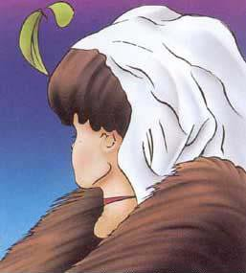
But Now Look Beyond the Obvious

Slide 16

Beyond the Obvious
Critically Think!

Slide 17
Multiple Causes of WW I
Militarism (Spending, Keeping up with the Cousins)
Alliances (Open and Secret, and of course the beloved Italians)
Imperialism (esp. Social Darwinism, The Scramble for Africa, the East, and beyond)
Nationalism (Deflection from ?)
Significant individuals, yet there are still:
---------------------------------------------------------------
Other Concerns: French Revanche, American Investments, an Assassination, a Telegram, etc...

Slide 18

Case Study Two:
The Sino-Soviet Split

Slide 19

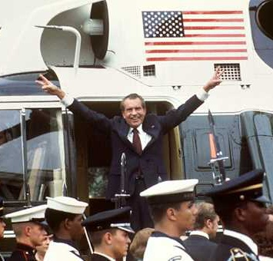
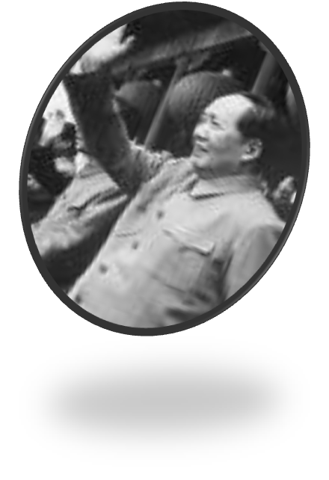
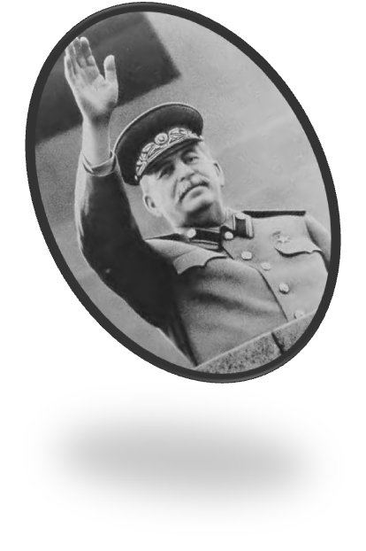
Why a Split?
To many an American, that’s an easy one!
“PLAYER?”

Slide 20

Reality Strikes!

Slide 21

Brothers in Arms: The Rise and Fall
of the Sino-Soviet Alliance, 1945-1963
Odd Arne Westad, ed

Slide 22
Sino-Soviet Schism
Historical Negative Feelings
Soviet Disinterest in a Unified China
Fear of a United States Preemptive Strike
China’s Feeling of Inferiority (lack of equal-partner status)
Khrushchev’s Denunciation of Stalin (20th Party Conference)
Mao’s World Revolution v. Khrushchev’s Peaceful Coexistence (de-Stalinization)
  The Soviets move too far to the right in the post-Stalin Era

Slide 23
Sino-Soviet Split
6. Mao’s World Revolution v. Khrushchev’s Peaceful Coexistence (de-Stalinization)
  The Soviets move too far to the right in the post-Stalin Era
7. Mao’s Fear of over-reliance on one Nation (Help with Korea, Nukes, etc…)
8. Difference in Ideological Pace &
Methods

Slide 24

The Sino-Soviet Split: Cold War in the Communist World
Lorenz M. Luthi

Slide 25
Sino-Soviet Schism
Ideological & Economical Differences
  Differing Beliefs over the relationship with the Capitalist World (disagreement over Best Path)
Internal Policies Within the Two Camps
  Especially Those under Mao who were Pro-USSR
  Mao uses anti-Soviet Propaganda at home to Help Himself
  Mao pushes for Chinese Isolationism
De-Stalinization
Personality Clashes
  Especially between Mao & Khrushchev

Slide 26

We Backtrack to
A Detailed Look at China
(1949 – 1991)

